Slide 1
Oversimplified Description of Effector and Memory CD8 T cell Differentiation
IL-7Ra high
IL-7Ra high
Acute Viral Infection
KLRG-1 low
KLRG-1 low
Perforin low
Perforin low
T-bet low
T-bet low
Antigen +
Cytokines
Eomes high
Eomes high
Memory CTL
Naïve
T-bet high
Eomes high
IL-7Ra low
death
KLRG-1 high
Perforin high
Cytotoxic activity
Clonal expansion
Contraction Memory
Day 8
(peak response)
Day 0
Day 30+

Slide 2
Scheme of the optimized pooled shRNA-screen
during LCMV infection
Chen R.Q.*, Bélanger S.*, et al. Immunity 2014;41:325-338

Slide 3
Screen hits based on three different bioinformatics analysis
DEseq
DEseq
32
1
29
8
28
28
GSEA
QN
GSEA
QN
1
12
Total:116
Total:116
ACTL6B
PPARGC1A
ARID1A
SMARCC2
CHD8
HDAC1
HDAC10
HDAC2
HDAC3
HDAC8
JMJD1C
KDM1B
KDM3A
KDM4D
KDM5B
KDM5D
KDM6A
MBD1
MBD2
MBD3
MECP2
MLL1
MLL2
MLL3
MLL5
WDR5
BRD1
BRD2
BRDT
BRPF1
MTA1
MTA2
NCOR1
NCOR2
L3MBTL1
L3MBTL2
L3MBTL3
PHF19
PRDM10
PRDM11
PRDM12
PRDM13
PRDM14
PRDM15
PRDM8
PRDM9
CARM1
PRMT5
PRMT6
PRMT7
PRMT8
AFF1
RNF20
TET1
TET3
GTF2B
GTF2F1
GTF2H1
GTF3C4
TAF1
TAF3
ARID1B
BRWD1
SMARCA2
SMARCA4
SMARCC1
SMARCD2
SMARCE1
BRD3
BRD4
DNMT3B
DNMT3L
GADD45A
GADD45B
DMAP1
HAT1
KAT2B
MYST1
MYST2
NCOA3
INO80
KDM2B
KDM3B
MTA3
CHD3
CHD4
CHD7
CHD9
TRIM28
ASXL1
BMI1
CBX5
CBX6
CBX7
EPC1
EPC2
EZH2
L3MBTL4
PCGF5
RNF2
SCML2
SCML4
PRDM1
PRDM16
PRDM4
PRDM5
PRDM6
PADI1
PADI4
RNF40
FBXL19
FBXO17
FBXO44
FBXW9
ELP4
PAF1
TET2
BAF complex
Polycomb group
Histone Deacetyltranferase
Prdms
Histone Acetyltranferase
MBD1,2,3,4, MECP2 family
Mll complex
NuRD complex
Transcription factor II
Depleted from effector cells
Depleted from memory precursor cells

Slide 4

An adoptive transfer system to evaluate CD8 T cell differentiation during LCMV infection
P14 Thy1.1
C57BL/6 Host
(Thy1.2)
d
Isolate Splenocytes
Naïve CD8
5x10⁵ cells
1.5x10⁵ PFU
LCMV-Clone-13
shRNAs (Ametrine)
-23 hr
-5 hr
-1 hr
Day 0
Day 8
Activate
Transduce
Transfer
Infection
Analyze
Notes:
REMEMBER Ago2 is proteosomally degraded during activation!!!!!! Totally gone by 48hrs!!!!!

Slide 5
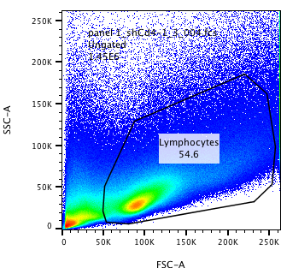
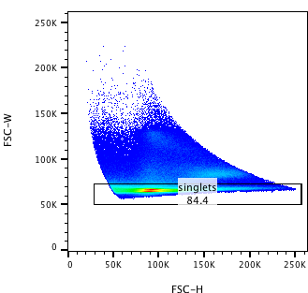
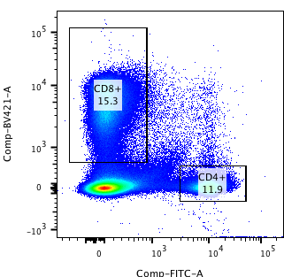
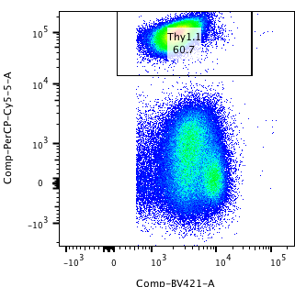
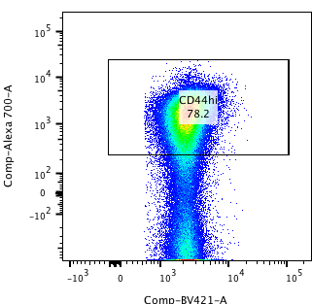
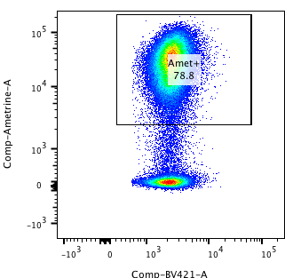
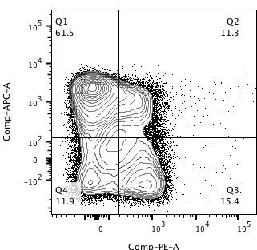
Gating Strategy for D8 Adoptive Transfer Analysis
Lymphocytes
Singlets
CD8s
P14+
CD8
Thy1.1
CD4
CD8
CD44hi
Ametrine+
KLRG1 vs CD127
CD44
Ametrine
KLRG1
CD8
CD8
CD127

Slide 6
P14+ Cd8s transduced with Prmt shRNAs expand in response to infection

Slide 7

shRNAs targeting Prmt5 inhibit memory precursor CD8 T cell differentiation
P14 cells+shRNAs-RV
Analyze 8 days
after infection
+ LCMV
shCd4.1
shPrmt5.1
shPrmt5.2
shPrmt5.3
shPrmt5.4
KLRG1
IL7Ra
KLRG1(%+)

Slide 8
shRNAs targeting Prmt5 enhance DPEC CD8 T cell differentiation

Slide 9
shRNAs targeting Prmt5 enhance in vivo T-bet expression and in vitro IFNg production
Relative Cell #
shPrmt5.2
Relative Cell #
shPrmt5.2
shPrmt5.2
shCd4.1
shCd4.1
shCd4.1
T-bet
IFNg

Slide 10
shRNAs for Prmt5 enhance CD25 expression under low IL-2 conditions
Prmt5.1
Prmt5.3
Z-Score (based on all shRNAs)
Prmt5.4
Prmt5.2
shCd4

Slide 11
Summary
shRNAs targeting Prmt5 inhibit memory precursor CD8 T cell differentiation
shRNAs targeting Prmt5 enhance in vivo T-bet expression and in vitro IFNg production
shRNAs targeting Prmt5 enhance DPEC CD8 T cell differentiation
Currently working on…
RNA Pol II ChIP
Histone modification ChIP (highly transcribed/correlate with RNA pol II occupancy)
H3K4me3
H3K4me36

Slide 12
Titrating ChIP Conditions
300 million D5 CD8s
X-link 1% Formaldehyde; 10 min 37 C
X-link 1% Formaldehyde; 10 min RT
Wash, pellet, freeze
Wash, pellet, freeze
Resuspend in ChIP lysis Buffer
-1% SDS
-10mM EDTA
-50 mM Tris-HCl
Aliquot and Titrate MNase
10 min RT;10 million cells/concentration
0, 500, 1000, 2000 and 5000 U/mL
De-Crosslink O/N 65C
PCI Extraction/Ethanol Precipitation
Resuspend and Analyze on 3.3% Agarose Gel

Slide 13
What is the role of Cyclin T1? Multiple Steps Regulate RNA Pol II Transcription
(1)
Recruitment
and Pre-Initiation
(2)
Promoter Escape
and Pausing
(3)
Transcriptional
Elongation
NELF (Negative Elongation Factor)
DSIF (DRB Sensitivity Inducing Factor)
RNA Pol II
Full-length RNA
GTFs
Promotor
Elongation
DNA
TSS
C-Terminal
Domain (CTD)
Ser 5
Ser 5
Ser 2
CyclinT1
CDK9
P-Tefb
Reviewed by Nechaev 2011

Slide 14
shCd4.1
shPrmt5.1
shPrmt5.2
shPrmt5.3
shPrmt5.4

Slide 17
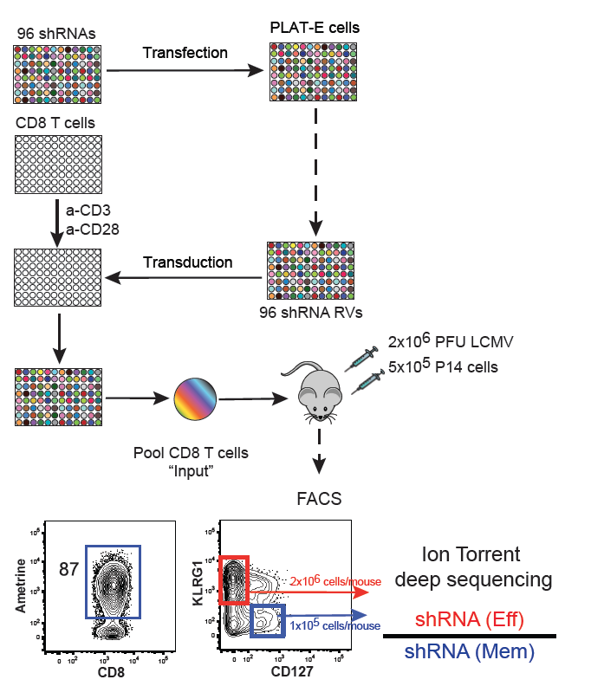
Technical Layout of the Arrayed Screen
shRNA library
Runx3 cDNA
D-2
Transfect Plat-E
D0
Activate CD8s
shRNA:Runx3
4:1
Quantify Phenotypic
Markers from each Gated Subset
D1
Co-transduce
D2
Reculture in high and low IL-2
Live Cells
Singlets
Viability Dye
FSC-W
Ametrine
D6
Stain and Analyze
FSC-A
FSC-H
GFP
Notes:
Animate

Slide 18
The Concentration of IL-2 in Culture Affects Expression of Multiple Surface Markers Under Screening Conditions
High IL-2
Low IL-2
CD44
CD25
CD127
CD62L
CXCR3
CD103
Notes:
High and low IL-2 conditions induce effector and memory CTL characteristics, respectively

Slide 19
Prdm4 and Prmt5 KD affects Runx3 driven suppression of CXCR3
Runx3
Z-Score (based on all shRNAs)
Prdm4
Prmt5

Slide 20
Prdm4 and Prmt5 KD affects Runx3 driven suppression of CXCR3
shCd4.1+pMig
shCd4.1+Runx3
shPrdm4.1+Runx3
shPrdm4.2+Runx3
shPrdm4.3+Runx3
shPrdm4.4+Runx3
Relative Cell #
shPrmt5.1+Runx3
shPrmt5.2+Runx3
shPrmt5.3+Runx3
shPrmt5.4+Runx3
CXCR3

